Slide 1

Multiple Access Control-II
Lecture (Theory)

Slide 2
Index
,
Concept Multiple Access Resolution
Control Access
Reservation Polling Token Passing
PiggyBacking

Slide 3
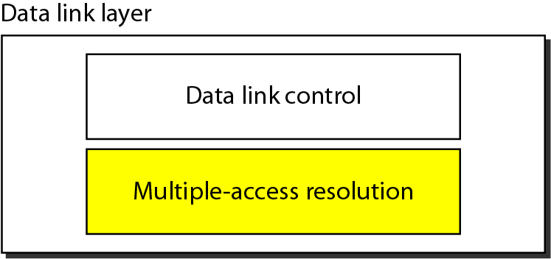

Slide 4
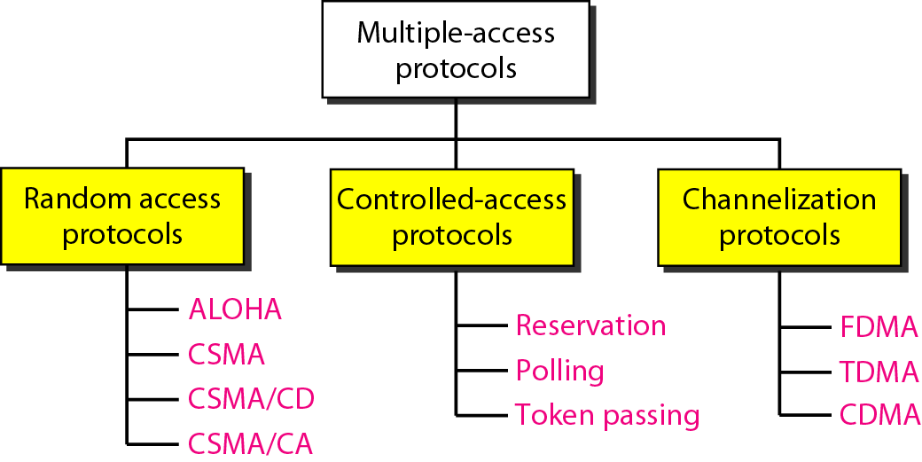

Slide 5
CONTROLLED ACCESS
In controlled access, the stations consult one another to find which station has the right to send.
A station cannot send unless it has been authorized by other stations.
There are three popular controlled-access methods.

Slide 6
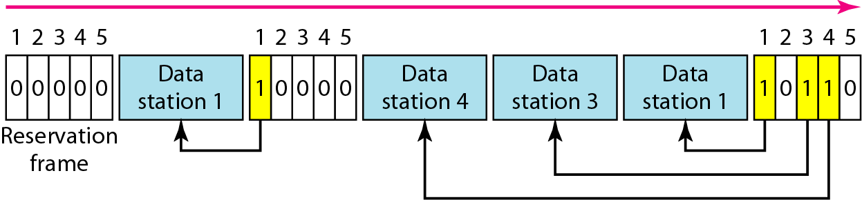
Reservation access method
Figure 1 Reservation access method

Slide 7
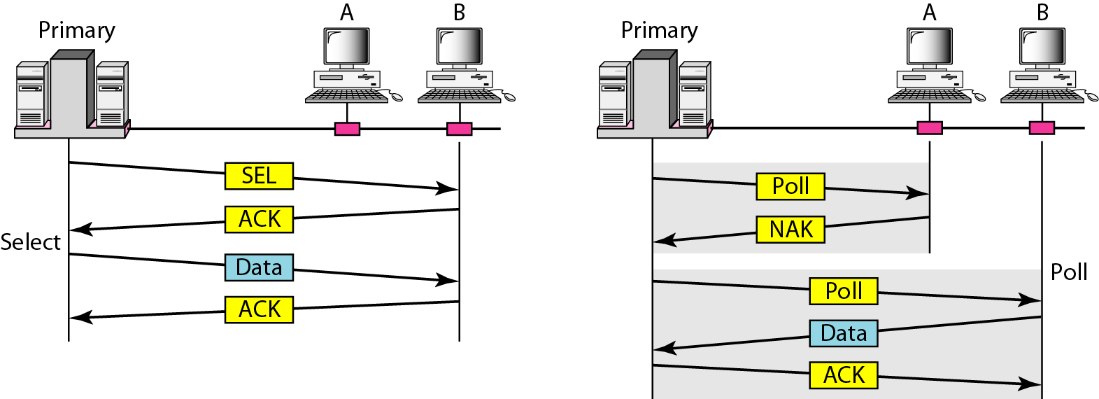
Select and poll functions in polling access method
Figure 2 Select and poll functions in polling access method

Slide 8
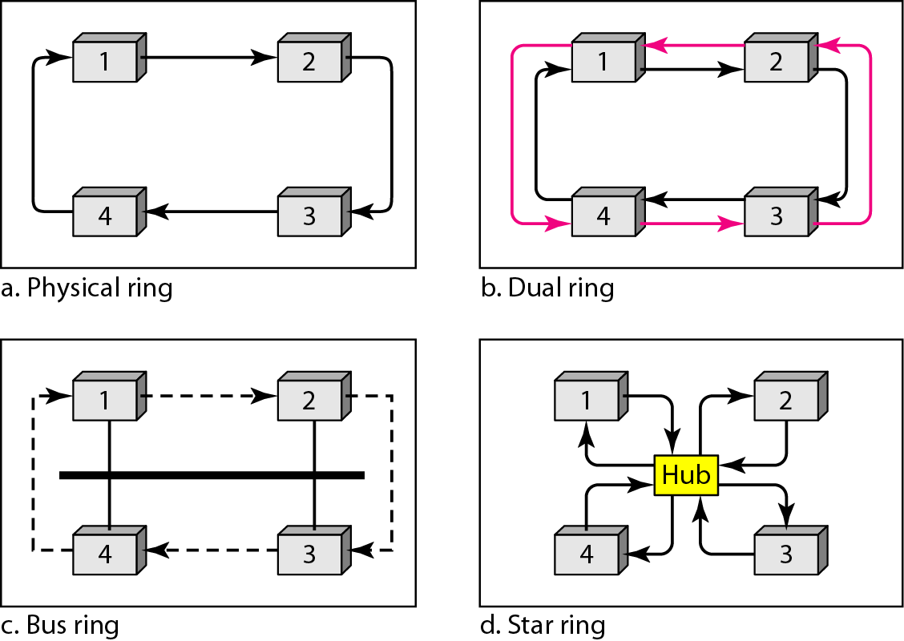
Logical ring and physical topology in token-passing access method
Figure 3 Logical ring and physical topology in token-passing access method

Slide 9
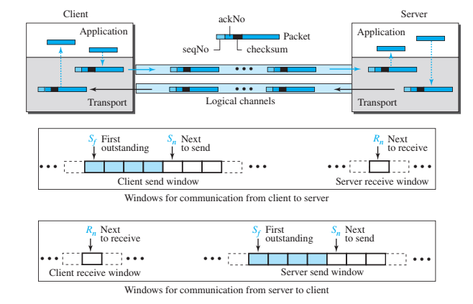
Piggybacking
﻿The client and server each use two independent windows: send and receive.

Slide 10
Piggybacking
Two Separate Channels: One way to achieve full-duplex transmission is to have two separate channels with one for forwarding data transmission and the other for reverse data transfer (to accept). But this will almost completely waste the bandwidth of the reverse channel.
Piggybacking: A preferable solution would be to use each channel to transmit the frame (front and back) both ways, with both channels having the same capacity. Assume that A and B are users. Then the data frames from A to B are interconnected with the acknowledgment from A to B. and can be identified as a data frame or acknowledgment by checking the sort field in the header of the received frame.

Slide 11
Piggybacking
Advantages of Piggybacking
The major advantage of piggybacking is the better use of available channel bandwidth. This happens because an acknowledgment frame needs not to be sent separately.
Usage cost reduction.
Improves latency of data transfer.
To avoid the delay and rebroadcast of frame transmission, piggybacking uses a very short-duration timer.
Disadvantages of Piggybacking
The disadvantage of piggybacking is the additional complexity.
If the data link layer waits long before transmitting the acknowledgment (blocks the ACK for some time), the frame will rebroadcast.

Slide 12
Practice Questions and Reference Links
https://www.geeksforgeeks.org/controlled-access-protocols-in-computer-network/
https://www.geeksforgeeks.org/multiple-access-protocols-in-computer-network/
https://www.javatpoint.com/multiple-access-protocols
https://pinoybix.org/2017/07/mcq-in-network-layer-internet-protocol-forouzan.html
https://edurev.in/course/quiz/attempt/-1_Test-Ipv4--IP-Packet/0decdb37-7206-4824-afdd-d47013a5c4cd

Slide 13
Thank you

Slide 14
Break Time

